Slide 1



CS 2110 Lab 14: Type Declarations and GDB Wednesday 3/30/2022
GDB
you

Slide 2
Homework 8 — GBA
Create an interactive graphical application for the GameBoy Advance using C!
Due Monday 4/4 at 11:59 PM
Files available on Canvas
Submit on Gradescope (unlimited submissions)
Standard grace period applies
Will be demoed

Slide 3
Hiring Dates
Tuesday March 29 – Application opens
Tuesday April 5 – Application closes
One week window
April 8 and April 11 – TA interviews
April 11 night – TA selection

Slide 4
Attendance
Will be taken for Quiz 4 and Timed Lab 4

Slide 5
Reading C Type Declarations
char *(*(**foo[][8])(int))[]; // huh?????

Slide 6
Review
Describe these types in English:
char *c;
int arr[8];
char *argv[];
int (*matrix)[8];
int (*add)(int, int);

Slide 7
Derived Types
All types have:
exactly one base type: int, char, struct coord, etc.
zero or more derived types:
* — "pointer to..."
[] — "array of..."
[n] — "array of n …"
... (...)(args) — "function taking args and returning ..."

Slide 8
How do I read a declaration?
Find the identifier name, e.g. "x" in "int x;"
Read as far right as you can until:
You hit a close paren ')', or
You reach the end of the declaration
Go back and read as far left as you can until:
You hit an open paren '(', or
You reach the beginning of the declaration
If you hit parentheses, exit the parentheses
Go to 2 and repeat until you read the whole declaration

Slide 9
Example
long ** foo[7];

Slide 10
Example – find identifier name
long ** foo[7];
"foo is..."

Slide 11
Example – read right as far as you can
long ** foo[7];
"foo is an array of 7..."
We hit the end of the declaration, so we go back and read left

Slide 12
Example – go back and read left
long ** foo[7];
"foo is an array of 7 pointers to..."
long ** foo[7];
"foo is an array of 7 pointers to pointers to..."
long ** foo[7];
"foo is an array of 7 pointers to pointers to longs"

Slide 13
Another Example
int *(*foo[5])(char*);
"foo is..."
Where do we go next?

Slide 14
Another Example
int *(*foo[5])(char*);
"foo is an array of 5..."
We hit a ')', so we go back and read left

Slide 15
Another Example
int *(*foo[5])(char*);
"foo is an array of 5 pointers to..."
We hit a '(', so we exit the parens and read right again

Slide 16
Another Example
int *(*foo[5])(char*);
"foo is an array of 5 pointers to functions taking a char* and returning..."
We hit a '(', so we exit parens and read right again

Slide 17
Another Example
int *(*foo[5])(char*);
"foo is an array of 5 pointers to functions taking a char* and returning a pointer to..."
int *(*foo[5])(char*);
"foo is an array of 5 pointers to functions taking a char* and returning a pointer to int"

Slide 18
Optional Challenge
char *(*(**foo[][8])(int))[];
(We won't ask you anything this hairy!)
Notes:
https://cdecl.org/?q=char+*%28*%28**foo%5B%5D%5B8%5D%29%28int%29%29%5B%5D%3B

Slide 19
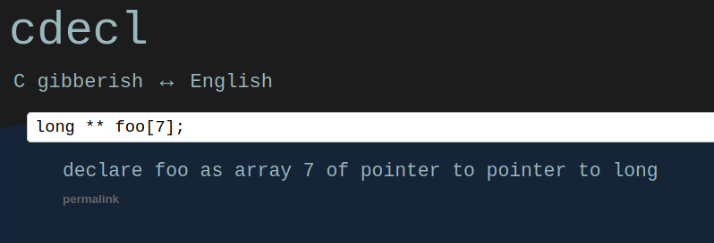
Good Resource: cdecl
https://cdecl.org/
Try playing around with different type declarations!

Slide 20
Make

Slide 21
Why?
Build commands can get long and complicated
What if you have hundreds of files?
Need some way to manage
Don’t want to redo work
Usually compile C files in parallel and link at end
Keep track of which files need to be recompiled
Not just for compilation
“You can also use Make … [for] anything else you want to do often enough to make it worth while writing down”

Slide 22
Structure
Build specified by a Makefile
Makefiles are mostly rules
Name of target (usually the output file)
Dependencies of target
Commands to make target
Targets can be files or PHONY targets (e.g., all, clean)

Slide 23
Live Example

Slide 24
Other Tools
CMake (Most Popular)
Generates files for Make or Ninja
GNU M4 and Autoconf
Generates files for Make
Ninja
“Where other build systems are high-level languages Ninja aims to be an assembler.”
Very fast

Slide 25
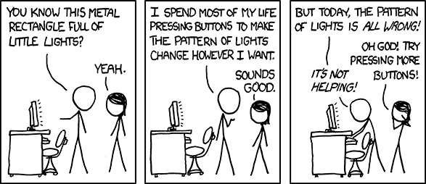
GDB
debugging, made better

Slide 26
Debugging
A lot of development time is spent fixing code
Logical errors and runtime errors are generally the harder ones to fix
It is possible to use printf for basic debugging
However, using tools specialized for the job is far more productive, particularly for more complex bugs and software
We’ve seen this earlier in the semester with Complx

Slide 27
GDB
gdb → GNU Debugger
Command line tool that lets you inspect and debug your code from within a shell/terminal
Very powerful and can save you HOURS of time
Used as a backend by many C IDEs
For this class, it is much easier if you just run it from within Docker
It can also be installed locally using your package manager of choice (brew, apt, nix, dnf, ...)

Slide 28
Getting started with GDB
First, we need to compile our code for gdb
gcc -g -o <name-of-output-file> <source-file>
-g tells the compiler to add debug information, which GDB needs in order to work
-o lets you rename your output file (the default filename is a.out)
The Makefile we give you does this for you automagically when you run make tests

Slide 29
GDB Commands
gdb <name-of-output-file>
Starts gdb and loads it with <name-of-output-file>
Alternatively, with our Makefile:
make run-gdb TEST=<name of test case>
make run-gdb TEST=test_addAnimal_long_species
The following commands must be run from within gdb:
run <args>
Runs the program to be debugged
Whatever arguments you pass in will be passed along to the program

Slide 30
GDB Commands (continued)
break <where>
Sets a new breakpoint at <where>
<where> = function-name | line-number | file:line-number
watch <what>
Sets a new watchpoint on a variable or expression
The program will pause when <what> changes
step
Run the next line of code, stepping into any functions
next
Run the next line of code, stepping over any functions

Slide 31
GDB Commands (continued)
print <what>
Prints <what> to the console
<what> = variable-name | expression
display <what>
Prints <what> to the console, but every step after it will continue to print <what>
backtrace
Displays the call stack
Useful for debugging seg faults

Slide 32
GDB Commands (continued)
finish
Finish the current function execution (i.e. run every line until you return to the caller)
record
Record history starting now
You can go back using this history using the reverse-step or reverse-next commands
You cannot go backwards unless you record history

Slide 33
GDB on the GBA
mGBA has GDB support
GDB runs the same as on regular C files
We give you a make target to make running gdb easy
In theory, very valuable
No printf on GBA
Testing requires lighting individual pixels (Sucks!)
Quite buggy on mGBA
Much more useful for HW9 and HW10

Slide 34
Live Debugging

Slide 35
Lab Assignment: Canvas Quiz
Go to Quizzes on Canvas
Select Lab 14
Password: backtrace
Get 100% for lab attendance credit
Unlimited attempts
Collaboration is encouraged!
Ask your TAs for help :)

